Slide 1
室外吸烟区的设置

Slide 2
室外吸烟区设置原则
远离人流多的地方
离开门窗
不能太舒适
要有明确的指示
要有禁烟标示

Slide 3
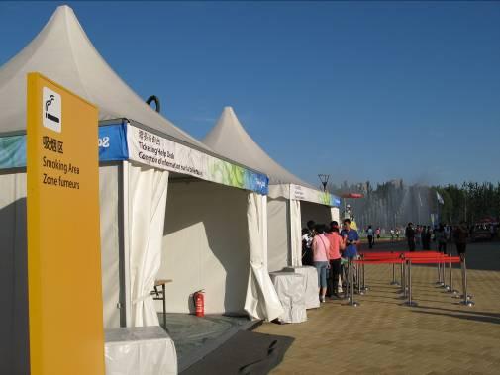
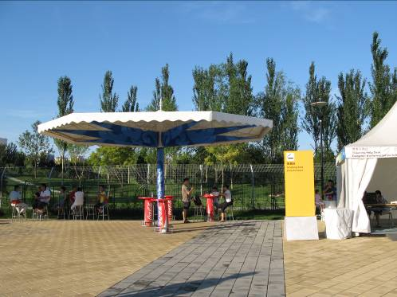
Designated smoking area at Beijing Olympics: Outdoor, no roof, no services, no rest area, no seating. Away from: pedestrian areas, entrances, congested areas, Organisational (Olympic) signage.

Slide 4
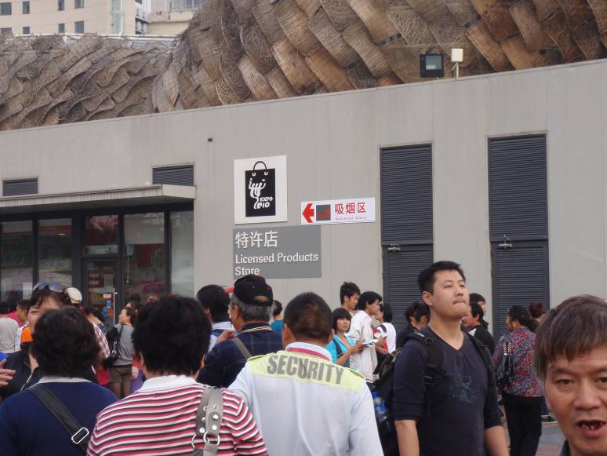
Wayfinding signage at Shanghai Expo indicating location of designated outdoor smoking area

Slide 5
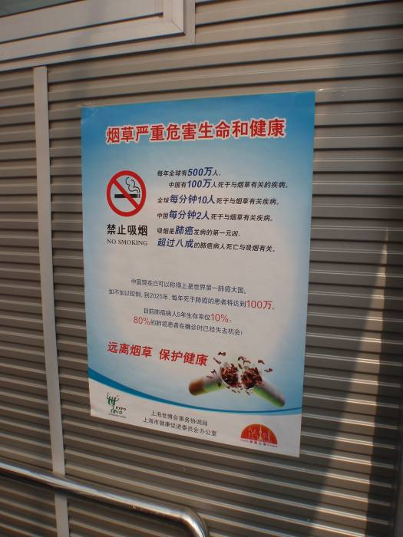
Educational material on the harms of tobacco on display in designated smoking areas in Shanghai Expo.

Slide 6
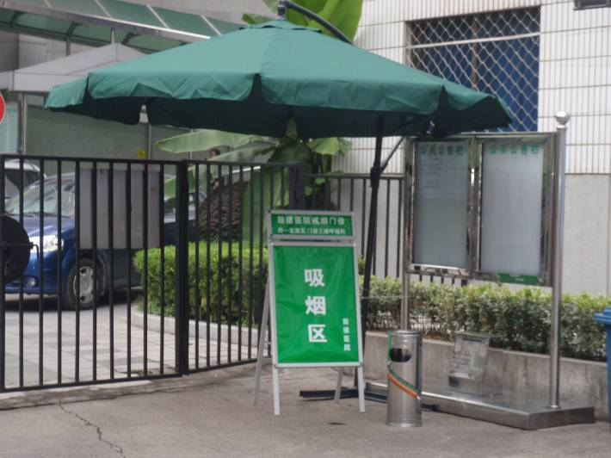
A designated smoking area in a health facility: it should be 10m from the window or any air intake for the building.

Slide 7
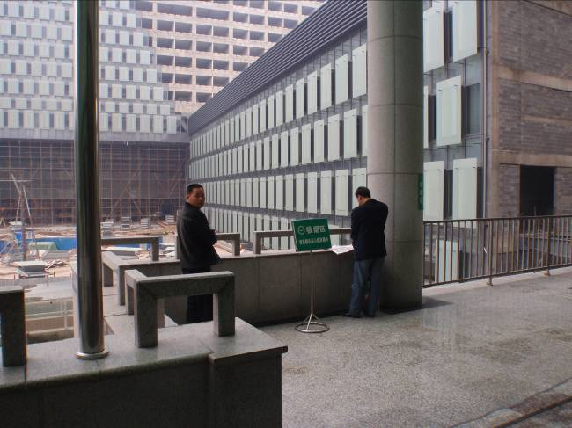
A designated smoking area in a hospital. This area does not have a roof and is NOT in a high traffic pedestrian area/transit zone.

Slide 8
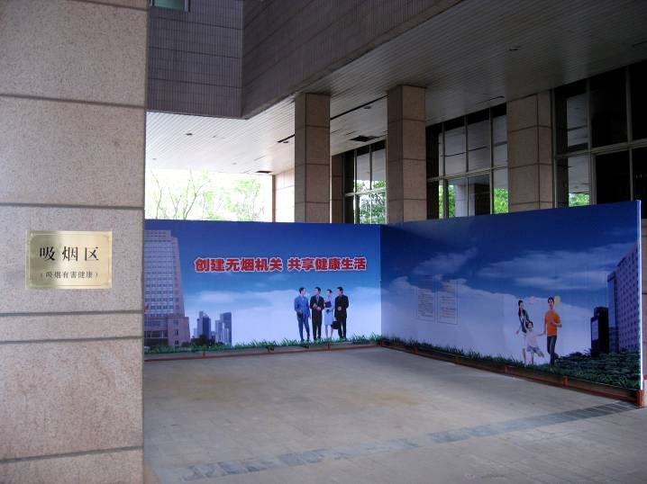
Ministry of Health designated smoking area. This area has no roof above it and is about 10m from the building. It is out of sight of the main entrance.

Slide 9
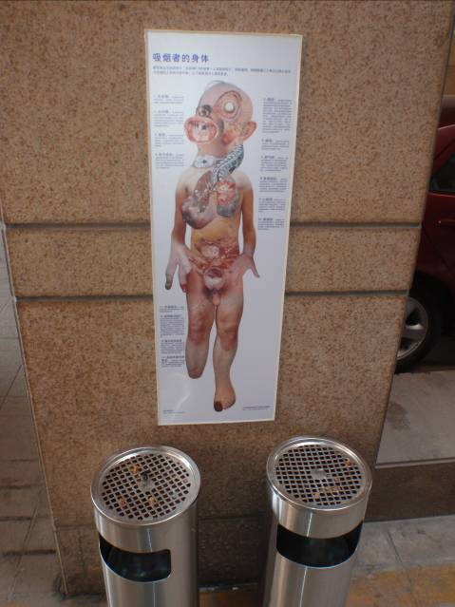
“Smokers’ Body” poster in the Ministry of Health designated smoking area. Smoking areas should have warnings on the harms of tobacco and information on where to get help to quit smoking. The national quitline is: 4008105180

Slide 10
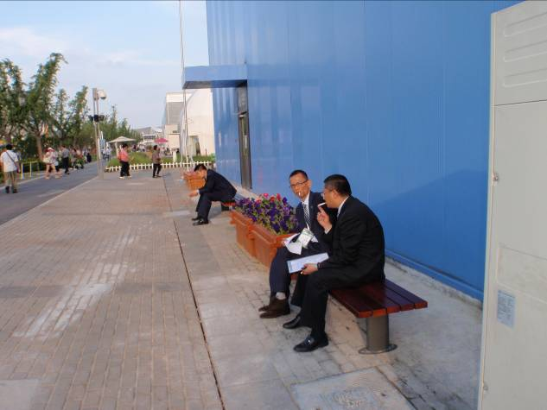
Staff/employees should not smoke in front of the building.

Slide 11
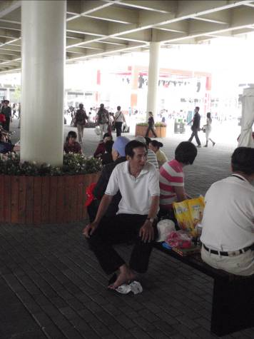
No one should smoke under a roof.

Slide 12
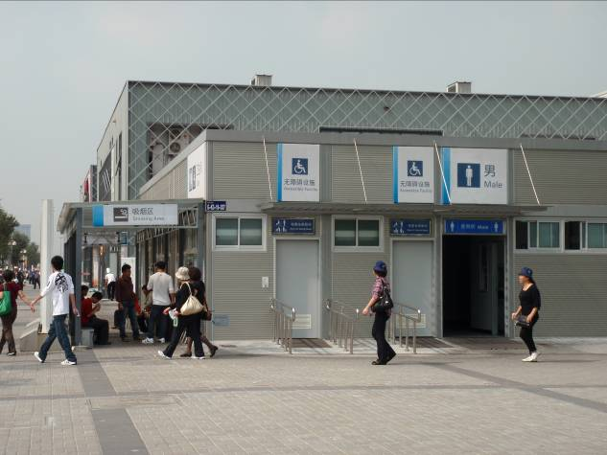
Keep designated smoking areas 10m away from pedestrian areas, buildings, entrances, windows, air intakes. They should not have a roof.

Slide 13
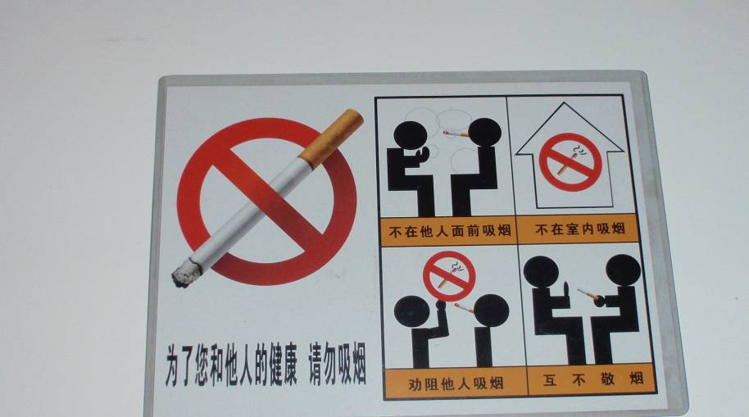
Good example of signage.

Slide 14
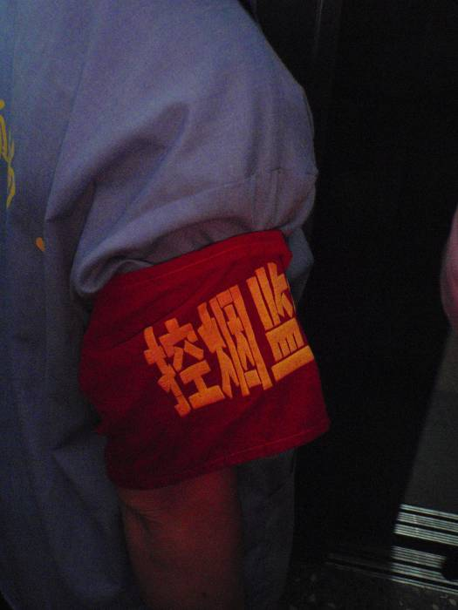
Staff including guards and cleaners are authorised and encouraged to enforce the smoke-free policy.

Slide 15
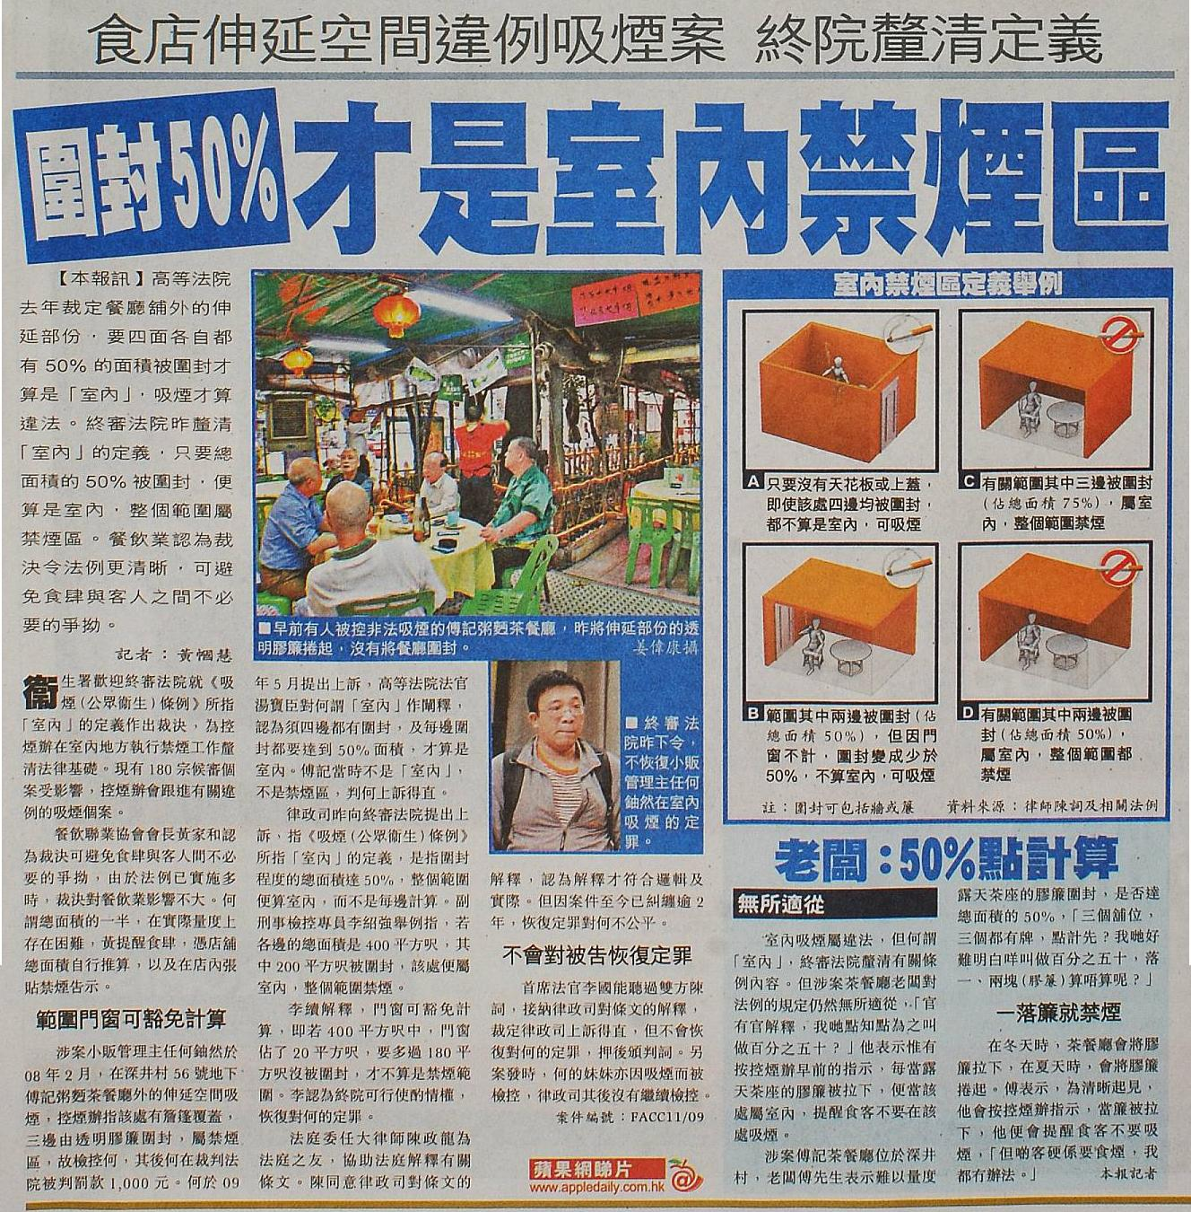
香港“室外”的定义

