Slide 1
实施世界卫生组织《烟草控制框架公约》
的国际经验和 MPOWER系列政策
Sarah England 博士
无烟草行动
世界卫生组织驻华代表处
Notes:
1

Slide 2
演讲结构:
烟草和非传染性疾病的负担
烟草控制的机制
实施世卫组织《烟草控制框架公约》的国际经验
关于烟草控制的几点想法
Notes:
2

Slide 3
烟草和非传染性疾病的负担
Notes:
3

Slide 4
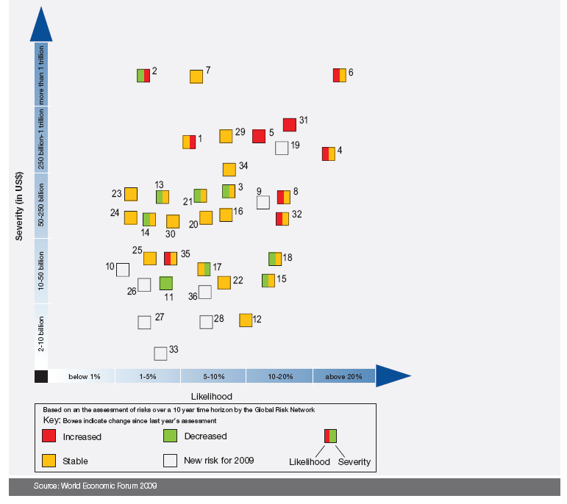
世界经济论坛
2009 全球经济风险形势
石油和天然气价格上涨
资产价格崩溃
慢病:
#4: 严重性
#3 可能性
经济损失的 严重性
金融危机
中国经济放缓
可能性

Slide 5
全球死亡比较
事件 | 死亡数量
烟草流行 | 仅二十世纪就有1亿人
第二次世界大战 | 5千万人
1918年流感大流行 | 2-5千万人
第一次世界大战 | 1.5千万人
伊波拉病毒 | 1000 – 2000人
非典 | < 800人 (大约 8000 例)

Slide 6
非传染性疾病的流行: 中国是全球趋势的一部份
占中国总死亡的80%，占伤残调整生命年损失的 70%
%
75
非传染性疾病
伤害
50
传染病，产妇和围产期疾病，营养不良
25
AFR
EMR
SEAR
WPR
AMR
EUR

Slide 7
烟草流行
负担的变化
从现在到2030年，烟草将会造成全球超过1.75亿人死亡
2005-2030年，烟草相关疾病累计死亡人数
烟草相关疾病死亡累计人数（百万）
全世界合计
发展中国家
发达国家
Notes:
7

Slide 8
烟草使用: 非传染性疾病的
一个主要可预防的危险因素
主要非传染性疾病:
可预防的危险因素:
肿瘤
糖尿病
慢性呼吸
系统疾病
心血管疾病
其他非传染性疾病
缺乏体力活动
不健康饮食
肥胖
烟草使用
酒精的有害使用
营养不良
Notes:
Tobacco use and second-hand smoke (SHS) damage every part of our body. Tobacco use is a risk factor for six of the eight leading causes of death in the world, including cardiovascular diseases, cancer, chronic obstructive pulmonary disease (COPD), lower respiratory infections and tuberculosis.
Tobacco is a growing epidemic. The tobacco epidemic already kills 5.4 million people a year from lung cancer, heart disease and other illness. That number will increase to 10 million a year in a few decades. Unless urgent action is taken, tobacco could kill one billion during the 21st century.
Tobacco use is growing fastest in low-income countries due to steady population growth coupled with tobacco industry targeting. If strong tobacco control measures are not implemented, the number of smokers in Sub-Saharan Africa is projected to increase 148% by 2030, to 208 million smokers(Jha & Chaloupka, 2000). Tobacco use is and will continue to be a significant driver in the epidemiological transition from communicable to chronic diseases in Africa.
Tobacco-related death is 100% preventable. We have the proven means to reduce tobacco use. Implementation of the key interventions outlined in WHO's MPOWER package can save millions of life. For example: 85% of lung cancer deaths, 27% of all cancer deaths are attributed to tobacco, which can be prevented (Peto et al. June 2006).

Slide 9
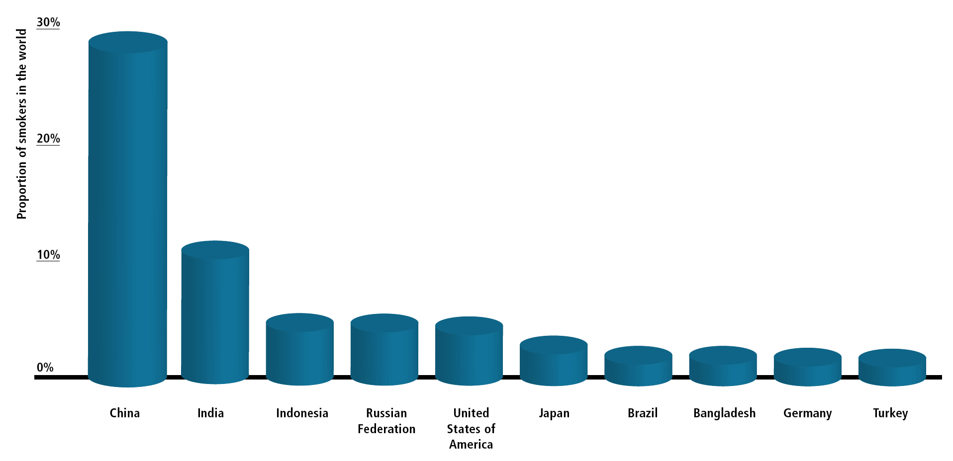
全世界约三分之一的吸烟者生活在中国
占全世界吸烟者的比例
More than 40% live in just 2 countries
中国
印度
印度尼西亚
日本
巴西
孟加拉国
德国
土耳其
俄罗斯联邦
美国
9
Notes:
The MPOWER Package
9
The tobacco epidemic will cause the most harm to low-income and moderate-income countries with high population
The tobacco industry is expanding its advertising, marketing and promotion to the developing world to capture these growing millions of potential customers
Tobacco use is growing fastest in these countries, fueled by steady population growth. This will create a ‘perfect storm’ of future tobacco-related disease and death
Because developing countries are still in the early stages of the tobacco epidemic, they have yet to experience the full impact of tobacco-related disease and death already evident in wealthier countries where tobacco use has been common for much of the past century
Many of these countries have fewer resources to respond to the health, social and economic problems caused by tobacco use, which will exacerbate the tobacco epidemic’s impacts
Tobacco-related disease and death will hit these countries very hard in the coming decades
9

Slide 10
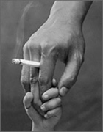
中国有
540,
000,
000
被动吸烟者
Notes:
No safe level of second-hand smoke
Smoke-free environments protect non-smokers’ health, help smokers quit & encourage smoke-free homes
Completely smoke-free indoor areas with no exceptions
Smoke-free laws very popular & do not harm business
Protect worker safety

Slide 11
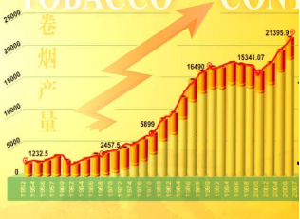
中国卷烟销售趋势

Slide 12

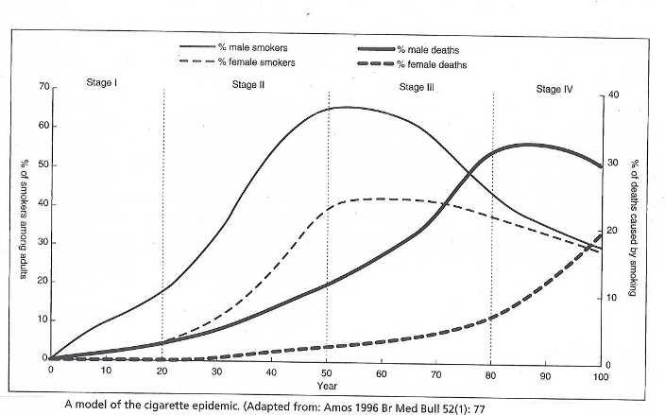
发达国家中，死亡人数峰值到达的时间
比吸烟人数峰值到达的时间晚30年
到2042年前，中国患病和死亡人数将要持续攀升
2012??
2042??

Slide 13
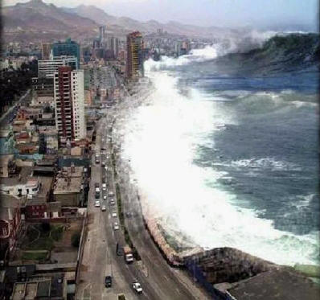

你可以阻止即将到来的烟草疾病如海啸般袭击中国
2006年中国烟草估计成本：
100万人死亡；
740亿元直接成本；
占卫生总支出的8%；
4.2 亿个工作日丧失。

Slide 14
非传染性疾病与贫穷
宏观经济水平
2006-2015年 (累计) | 2005年 | 因心脏病、中风和糖尿病过早死亡所致的国民收入损失
国民收入损失 (10亿) | 国民收入损失 (10亿) | 国家
49 | 3 | 巴西
558 | 18 | 中国
237 | 9 | 印度
8 | 0.4 | 尼日利亚
31 | 1 | 巴基斯坦
303 | 11 | 俄罗斯联邦
3 | 0.1 | 坦桑尼亚
世卫组织: "据估计，仅心脏病、中风和糖尿病就缩小了那些正经历经济快速增长的低和中等收入国家的1-5％的年国内生产总值"

Slide 15
烟草控制的机制
Notes:
15

Slide 16
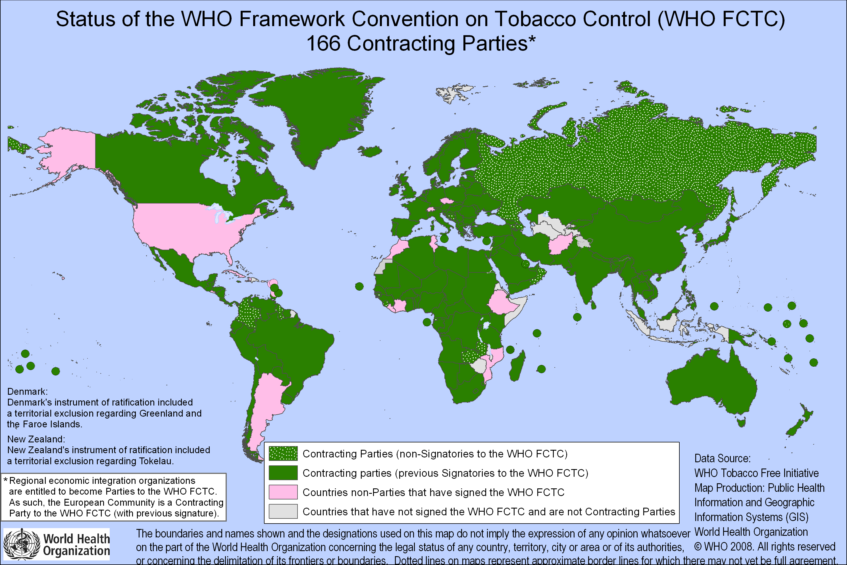
世界卫生组织《烟草控制框架公约》在公共健康领域具有里程碑意义
现有172个缔约方

Slide 17
世卫组织《烟草控制框架公约》在中国
世界卫生组织《烟草控制框架公约》要求做到无烟公共场所、工作场所和公共交通，以及禁止烟草广告。
中国于2005年10月批准该公约。
世卫组织《烟草控制框架公约》在中国是有约束力的法律。

Slide 18
MPOWER 技术援助项目: 实施世界卫生组织《烟草控制框架公约》中减少烟草需求的措施
MPOWER: 六干预扭转烟草流行的干预措施
M监测烟草使用与预防政策
P保护人们免受烟草烟雾危害
O提供戒烟帮助
W警示烟草危害
E确保禁止烟草广告、促销和赞助
R提高烟税

Slide 19

世界卫生组织《烟草控制框架公约》与 MPOWER系列政策
一个循证的烟草控制工具
r
p
w
第 6, 15条
第 8条
第 11, 12条
e
o
m
第 13条
第 14条
第20, 21条
Notes:
The placement of MPOWER logo is strategic as the MPOWER package is a tool that helps countries meet their FCTC guidelines

Slide 20
实施世卫组织《烟草控制框架公约》
的国际经验
尼日利亚，土耳其，
墨西哥，英国，伊朗，尼泊尔，
香港，印度，中国，巴拿马，泰国

Slide 21

世界卫生组织《烟草控制框架公约》
第20 和 21 条
(监测烟草使用与预防政策)
尼日利亚监测烟草公司的活动
  非政府组织 "环境权利行动/地球之友" (ERA/FOTE) 找出了烟草公司对烟农的不公正做法及对使用童工的漠视
  揭露了烟草公司存在吸引青少年吸烟的赞助活动。烟草公司在所赞助活动的场所免费派发香烟和烟草相关商品
  查获烟草公司与许多政府机构有合作及开展企业社会责任项目
Notes:
21
Egypt : Successful national school-based smoke free campaign held. This is creating 100% smoke-free schools (Ministry of Education in collaboration with MoH and The Directorate of Environmental Affairs).
Brazil: Decree passed on 12 May 2008 to ban smoking in all enclosed public places in Rio de Janeiro.
Mexico: Federal Tobacco Control law was approved and a 100% smoke-free law was approved in Mexico City on 30 May 2008, "Health Protection of Non-Smokers Law". The level of compliance is good, even though many actions against the law are under consideration.
Turkey: The national Tobacco control law was amended and signed by the President. The revised law provides 100% smoke-free public and workplaces with some minor exceptions. The first phase of 100% smoke-free public and workplaces will enter into force on 19 May 2008.

Slide 22
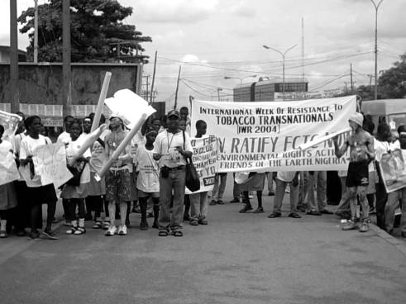
世界卫生组织《烟草控制框架公约》
第 20 和 21 条
(监测烟草使用与预防政策)
尼日利亚监测烟草公司的活动（续前）
  环境权利行动/地球之友 帮助一些小规模的非政府组织增强能力，使其能从事监测烟草公司及基层宣传工作
  牵头成立尼日利亚烟草控制联盟：一个积极从事反烟草斗争的非政府组织联盟
Notes:
22
Egypt : Successful national school-based smoke free campaign held. This is creating 100% smoke-free schools (Ministry of Education in collaboration with MoH and The Directorate of Environmental Affairs).
Brazil: Decree passed on 12 May 2008 to ban smoking in all enclosed public places in Rio de Janeiro.
Mexico: Federal Tobacco Control law was approved and a 100% smoke-free law was approved in Mexico City on 30 May 2008, "Health Protection of Non-Smokers Law". The level of compliance is good, even though many actions against the law are under consideration.
Turkey: The national Tobacco control law was amended and signed by the President. The revised law provides 100% smoke-free public and workplaces with some minor exceptions. The first phase of 100% smoke-free public and workplaces will enter into force on 19 May 2008.

Slide 23
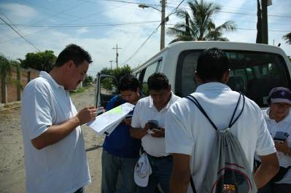
世界卫生组织《烟草控制框架公约》
第 20 和 21 条
(监测烟草使用与预防政策)
土耳其扩大烟草使用情况的调查
  土耳其初显对烟草使用监测的承诺，始于2003年其首次实施全球青少年烟草调查（GYTS）和世界卫生组织的世界卫生调查
  2009 年, 用全国代表性的样本重复了GYTS
  2009年一月, 土耳其成为了首个完成了全球成人烟草调查（GATS）数据收集工作的国家
Notes:
23
Egypt : Successful national school-based smoke free campaign held. This is creating 100% smoke-free schools (Ministry of Education in collaboration with MoH and The Directorate of Environmental Affairs).
Brazil: Decree passed on 12 May 2008 to ban smoking in all enclosed public places in Rio de Janeiro.
Mexico: Federal Tobacco Control law was approved and a 100% smoke-free law was approved in Mexico City on 30 May 2008, "Health Protection of Non-Smokers Law". The level of compliance is good, even though many actions against the law are under consideration.
Turkey: The national Tobacco control law was amended and signed by the President. The revised law provides 100% smoke-free public and workplaces with some minor exceptions. The first phase of 100% smoke-free public and workplaces will enter into force on 19 May 2008.

Slide 24
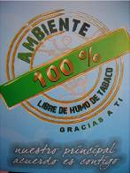
世界卫生组织《烟草控制框架公约》第 8 条
(保护人们免受烟草烟雾危害)
墨西哥联邦区实现了100%无烟
  拥有近900万人口的墨西哥联邦区 (墨西哥城), 2008年2月通过了全面禁止吸烟的法律。
  成为大型无烟地方管辖区的一员，墨西哥联邦区将成为推动拉丁美洲和世界各地类似行动的催化剂。
Notes:
24
Egypt : Successful national school-based smoke free campaign held. This is creating 100% smoke-free schools (Ministry of Education in collaboration with MoH and The Directorate of Environmental Affairs).
Brazil: Decree passed on 12 May 2008 to ban smoking in all enclosed public places in Rio de Janeiro.
Mexico: Federal Tobacco Control law was approved and a 100% smoke-free law was approved in Mexico City on 30 May 2008, "Health Protection of Non-Smokers Law". The level of compliance is good, even though many actions against the law are under consideration.
Turkey: The national Tobacco control law was amended and signed by the President. The revised law provides 100% smoke-free public and workplaces with some minor exceptions. The first phase of 100% smoke-free public and workplaces will enter into force on 19 May 2008.

Slide 25
中国
大学无烟环境法规
餐厅无烟环境法规
酒吧无烟环境法规
其它室内工作场所无烟环境法规
室内办公室无烟环境法规
医疗卫生机构无烟环境法规
政府机构无烟环境法规
教育机构无烟环境法规
地方一级无烟环境法规

Slide 26
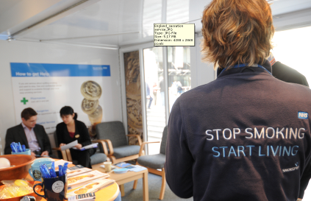
世界卫生组织《烟草控制框架公约》第14 条
(提供戒烟帮助)
英国给全民提供免费的、综合性的烟草依赖治疗服务
任何吸烟者可以免费到他或她的全科医生处寻求戒烟帮助并转诊接受专门治疗，或直接到专门治疗烟草依赖的中心接受治疗。
有两条免费的、全国性的戒烟热线。
尼古丁替代疗法可以非处方药的方式在药店和其他店（如超市）内买到。尼古丁替代疗法及其他戒烟药物也可以通过处方和折扣价获得。
Notes:
26
Indonesia: A top referral hospital and the Indonesian Medical Association developed new tobacco cessation centers in hospitals and private practice clinics (2008).
Bangladesh - National workshop on cessation held in May 2008.
India: STCCs of Tamil Nadu, West Bengal and Delhi have conducted workshops on Tobacco Cessation and training of trainers in Tobacco-Free Dental & Medical Colleges, as well as other training sessions on cessation (June 2008).
China: New cessation guidelines have been produced by Chaoyang Hospital. The draft guidelines were distributed at the Smoke Free Hospital Seminar held in Beijing in February 2008, as were the Chinese version of the WHO Guidelines for protection from SHS (March 2008).
Iran - Lots of work on cessation training - national training of trainers workshop on cessation, over 100 cessation centres set up.
Ghana: Training workshops for PHC providers on cessation counselling services in 12 health facilities. Guide for PHC providers to do cessation counselling has been developed (2007).
Nigeria: Training workshops have been conducted to train PHC providers on brief cessation advice. Provision of Incentives (blood pressure monitors) to encourage PHC providers to include cessation support as a component of the NCDs treatment (2007-2008) .
Nepal: Identification of smokers and provision of brief cessation advice have been incorporated into primary health care for chronic respiratory diseases and Tuberculosis(2007- June 2008).

Slide 27
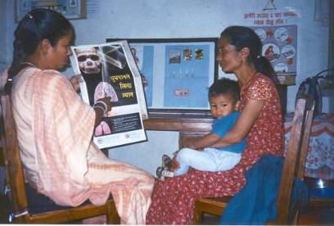
世界卫生组织《烟草控制框架公约》第 14 条
(提供戒烟帮助)
尼泊尔: 将戒烟服务整合到结核病服务项目中
由尼泊尔国家结核病防治规划领导进行
两个试点区的所有社区卫生服务中心均 通过实施“肺部健康实用方法”（PAL）项目为吸烟者提供戒烟服务
培训了来自25个社区卫生服务中心的146名卫生工作者 开展此项目
初步结果
门诊和住院病人中，患呼吸系统疾病的比例 | 6-10%
全部呼吸系统疾病患者中吸烟者所占比例 | 59%
现在吸烟的呼吸系统疾病患者接受了戒烟咨询服务的比例 | 22%
Notes:
27
Indonesia: A top referral hospital and the Indonesian Medical Association developed new tobacco cessation centers in hospitals and private practice clinics (2008).
Bangladesh - National workshop on cessation held in May 2008.
India: STCCs of Tamil Nadu, West Bengal and Delhi have conducted workshops on Tobacco Cessation and training of trainers in Tobacco-Free Dental & Medical Colleges, as well as other training sessions on cessation (June 2008).
China: New cessation guidelines have been produced by Chaoyang Hospital. The draft guidelines were distributed at the Smoke Free Hospital Seminar held in Beijing in February 2008, as were the Chinese version of the WHO Guidelines for protection from SHS (March 2008).
Iran - Lots of work on cessation training - national training of trainers workshop on cessation, over 100 cessation centres set up.
Ghana: Training workshops for PHC providers on cessation counselling services in 12 health facilities. Guide for PHC providers to do cessation counselling has been developed (2007).
Nigeria: Training workshops have been conducted to train PHC providers on brief cessation advice. Provision of Incentives (blood pressure monitors) to encourage PHC providers to include cessation support as a component of the NCDs treatment (2007-2008) .
Nepal: Identification of smokers and provision of brief cessation advice have been incorporated into primary health care for chronic respiratory diseases and Tuberculosis(2007- June 2008).

Slide 28
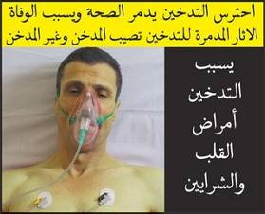
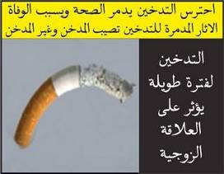
世界卫生组织《烟草控制框架公约》
第 11 和 12 条
(警示烟草危害)
伊朗实施了严格的烟草包装警示
  2008年，伊朗加强了其法律，要求从2009年1月始所有在该国出售的香烟包装都必须有图片警示
  所有的香烟包装，其上的健康警示覆盖正面和背面包装的50%
Notes:
28
Mexico: The new federal law in Mexico includes health warnings (30% of front with a pictogram, 100% of back, 100% of one lateral), a ban on misleading descriptors.
Brazil: A new set of health warnings was presented on WNTD.
Bangladesh: Consistent dissemination of anti-tobacco messages in national print and electronic media. Taskforce Committees have been activated in regions/districts in order to advocate on health warnings.
Viet Nam: The regulation on new health warnings became effective on 1 April 2008. There are two text health warnings covering 30% of the two main surfaces.
Poland: three-month long national education campaign about the threat of tobacco use and passive smoking and health promotion amongst children and teenagers (mainly 16-19 years old) started on 31 May 2008.
Egypt - new health warnings now available.

Slide 29

世界卫生组织《烟草控制框架公约》
第 11 和 12 条
(警示烟草危害)
中国和印度: 大众媒体宣传
  中国和印度播放了名为“海绵”的广告。该广告最初是由澳大利亚新南威尔士州的癌症研究所开发的。
  该广告以图象生动地描述了一个普通吸烟者一年内其肺部所吸收的致癌焦油的数量。
  印度政府花费了近100万美元用于此广告宣传，在2009年6月和7月期间，该广告在40个国家和地区电视频道上播放了6周。
由此可获得：http://www.encyclopedia.com/video/Yj_bW8rKB44-india-sponge-campaign-by-world.aspx
Notes:
29
Mexico: The new federal law in Mexico includes health warnings (30% of front with a pictogram, 100% of back, 100% of one lateral), a ban on misleading descriptors.
Brazil: A new set of health warnings was presented on WNTD.
Bangladesh: Consistent dissemination of anti-tobacco messages in national print and electronic media. Taskforce Committees have been activated in regions/districts in order to advocate on health warnings.
Viet Nam: The regulation on new health warnings became effective on 1 April 2008. There are two text health warnings covering 30% of the two main surfaces.
Poland: three-month long national education campaign about the threat of tobacco use and passive smoking and health promotion amongst children and teenagers (mainly 16-19 years old) started on 31 May 2008.
Egypt - new health warnings now available.

Slide 30
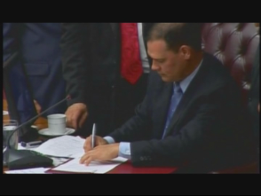
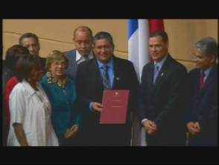
世界卫生组织《烟草控制框架公约》第 13 条
(确保禁止烟草广告、促销和赞助)
巴拿马禁止所有的烟草广告、促销和赞助
  2008年，巴拿马成为美洲第一个全面禁止所有烟草制品广告，促销和赞助的国家。
  尽管巴拿马的法律仅实行了不到两年，但遵守水平非常高，在满分是100分的评分中得到了95分。
新法律的签署
Notes:
30
Mexico: A wide, but not complete, ban on advertisement, promotion and sponsorship was approved with the Federal Law in March 2008 (magazines for adults are exempted).
China: China CDC released its 2008 China Tobacco Control Report, “Protect Children and Young People by Banning Tobacco Advertising, Promotion and Sponsorship”.
Philippines: The Philippines has already banned tobacco advertising on television, cable TV, radio, cinema and outdoor ads (billboards) since 2007, and on 1 July 2008, banned all forms of mass media advertising, including printed materials.
Bangladesh: Six shopkeepers in Dhaka City were fined for having tobacco advertisement billboards on their shops in violation of the advertising ban in May. A month long World No Tobacco Day (WNTD) observed in the country, focused on ad bans. As a result the last two months have seen an aggressive response from Government Ministries - removing advertising promotion boards in the streets and running mobile courts to enforce bans in districts.
Indonesia: Implementation of a project which aims at advocating for a ban of tobacco advertising, promotion and sponsorship (May 2008).
Thailand: Training for law enforcement in order to introduce the recently developed Ministerial Notifications and to strengthen enforcement at the provincial level (May 2008).

Slide 31
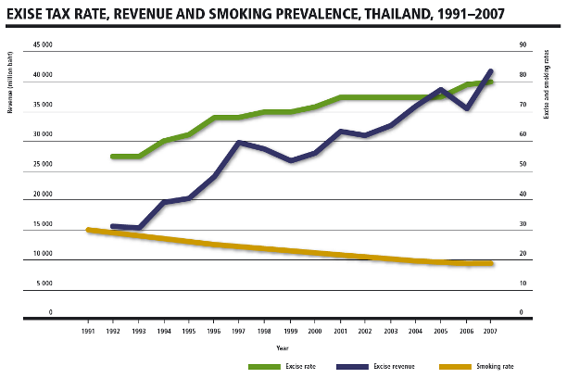
世界卫生组织《烟草控制框架公约》第 6 条
(提高烟税)
泰国增加了烟税 泰国对所有类别的卷烟征收了80％的从价消费税
Notes:
31
Bangladesh: Signature campaigns and major advocacy drives resulted in the Finance Adviser to the Caretaker Government of Bangladesh announcing new taxes on tobacco. This was followed by an announcement from the President in June to increase taxes. 60% taxes are now imposed on material and 20% on packaging.
Viet Nam: raised tobacco excise taxes to 65% of the factory price, up from 55%.
Pakistan: The Technical Advisory Group on tobacco control (high level political group) has been activated, and it has submitted recommendations to the government to increase taxation on tobacco products.

Slide 32
关于烟草控制的几点想法
Notes:
32

Slide 33

爱因斯坦说：
“树立榜样不是影响他人的主要方式，而是影响他人的唯一方式。”
Notes:
“Learning is like rowing upstream: not to advance is to drop back.” We need to make sure that we are moving forward in the fight against the tobacco epidemic.
Health professionals need to be leaders in the fight against tobacco. We need to quit smoking ourselves, and lead the movement against tobacco at all levels: health facility level, municipal level and nation-wide.

Slide 34
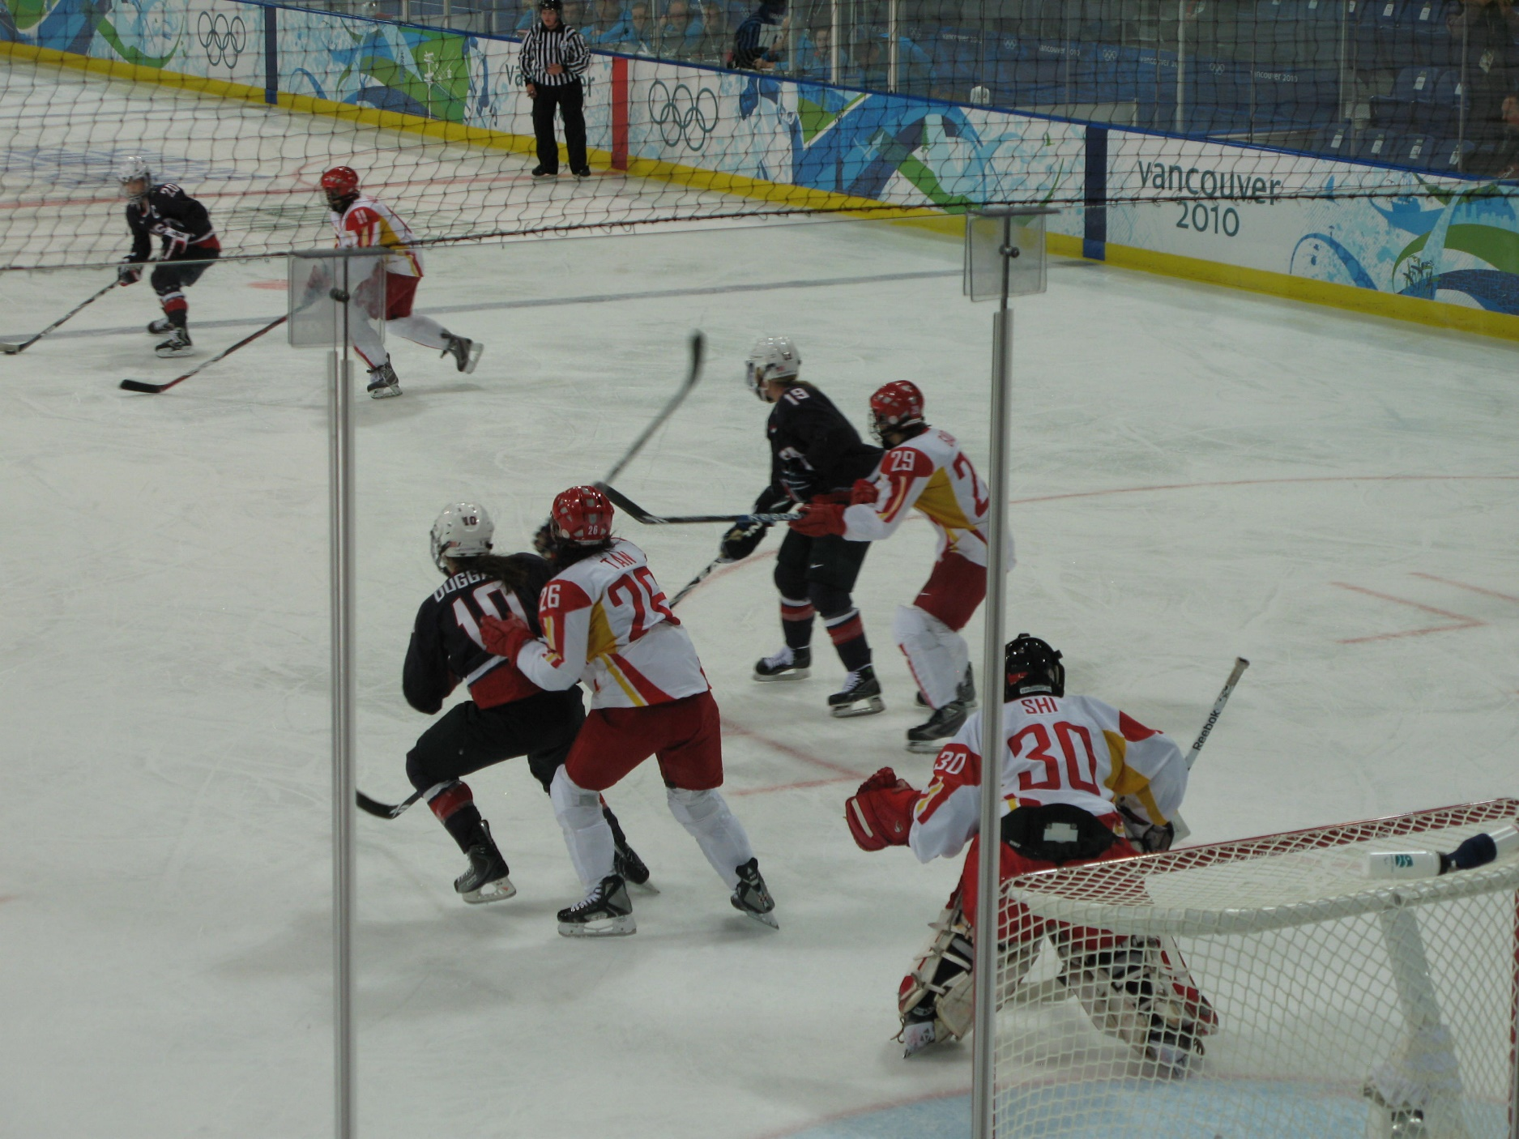
差之毫厘，失之千里
Notes:
This proverb advises that when doing something one must make every effort to be careful and exact, because even a tiny mistake can lead to a great loss. Tobacco control is a relatively new area in China and many policies, guidelines, and regulations are in development, including curriculum development. It is very important to make sure these policies are as close to perfection as we can make them. A small error may lead to ineffective policies and a failed mission.

Slide 35

大处着眼，小处着手
Notes:
This proverb advises us to always keep the overall situation in mind and be far-sighted while we set our hands to mundane business. Tobacco control is a marathon, not a sprint. Right now, demand for cessation services is not great, because we haven't built the system. People will want to quit smoking when they get that advice over and over from their doctor, when there are hard-hitting labels on the cigarette packs, when there are no ads urging them to smoke, when they can no longer smoke indoors, and when cigarettes are very expensive. Together these things will work to bring your patients to you asking for help. Health professionals have to be prepared with the right answers to give their patients who want to quit smoking, and they have to know how to motivate their smoking patients to quit. The first step is to make sure that you don't smoke yourselves. As medical professionals, you need to take the lead. The second is to make sure all doctors give brief cessation advice to all patients. You are going to contribute to this through the new curriculum on tobacco issues. This is the mundane business of tobacco control. However, these steps are necessary to combat tobacco, the biggest agent of death on the planet.

Slide 36

人心齐, 泰山移

