Slide 1
International experience of WHO FCTC implementation and MPOWER
Dr Sarah England
Tobacco Free Initiative
World Health Organization, China
Notes:
1

Slide 2
Presentation structure:
Tobacco and the non-communicable disease burden
Mechanisms of tobacco control
International experience in implementing the WHO FCTC
Some thoughts on tobacco control
Notes:
2

Slide 3
Tobacco and the Non-Communicable Disease Burden
Notes:
3

Slide 4
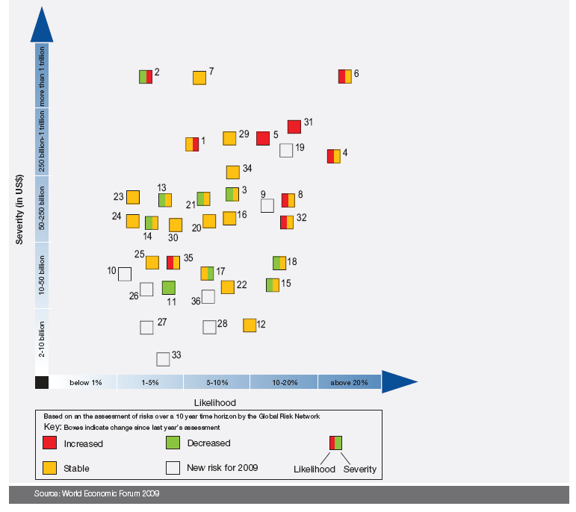
World Economic Forum
Global Economic Risks Landscape 2009
Oil and gas price spike
Asset price collapse
Chronic disease:
#4: severity
#3 likelihood
Severity of Economic Loss
Fiscal crisis
Slowing Chinese Economy
Likelihood
Notes:
I am sure that as health professionals you are aware of the enormous and increasing death toll in China from diseases attributable to tobacco. You are also no doubt aware that smoking cessation is one of the 6 key policies for stopping the tobacco epidemic. However, you may not be aware that chronic disease – for which tobacco is a key risk factor - is also a serious threat to the global economy. This year, for the second year in a row, the World Economic Forum surveyed the CEOs of its members to find out how they ranked global economic threats. These CEOs are business people, not public health experts. They rarely think about things like tobacco control. However, they ranked chronic disease as the number 3 and 4 threat to the global economy in terms of magnitude and likelihood of risk. The risk is in the order of hundreds of billions of US dollars. So in your work in promoting tobacco control as a component of the curriculum for health professionals, you are not only protecting public health, you are protecting the global economy.

Slide 5
Global Mortality comparisons
Event | # Deaths
Tobacco epidemic | 100 million in 20th century
World War II | 50 million
1918 Flu Pandemic | 20-50 million
World War I | 15 million
Ebola | 1000 - 2000
SARS | <800 (Around 8000 cases)

Slide 6
NCD epidemic: China part of Global Trend
80% of deaths and 70% of disability-adjusted life-years lost in China
%
75
Noncommunicable
conditions
Injuries
Communicable diseases, maternal and perinatal conditions and nutritional deficiencies
50
25
AFR
EMR
SEAR
WPR
AMR
EUR

Slide 7
The Tobacco Epidemic
A Shifting Burden

Slide 8
Tobacco Use: a Key Preventable Risk Factor of Noncommunicable Diseases
Major noncommunicable diseases:
Preventable risk factors:
Cancer
Diabetes
Chronic
Respiratory
Diseases
Cardiovascular
Diseases
Other NCDs
Physical inactivity
Unhealthy
diets
Obesity
Tobacco
use
Harmful use of alcohol
Malnutrition
Notes:
Tobacco use and second-hand smoke (SHS) damage every part of our body. Tobacco use is a risk factor for six of the eight leading causes of death in the world, including cardiovascular diseases, cancer, chronic obstructive pulmonary disease (COPD), lower respiratory infections and tuberculosis.
Tobacco is a growing epidemic. The tobacco epidemic already kills 5.4 million people a year from lung cancer, heart disease and other illness. That number will increase to 10 million a year in a few decades. Unless urgent action is taken, tobacco could kill one billion during the 21st century.
Tobacco use is growing fastest in low-income countries due to steady population growth coupled with tobacco industry targeting. If strong tobacco control measures are not implemented, the number of smokers in Sub-Saharan Africa is projected to increase 148% by 2030, to 208 million smokers(Jha & Chaloupka, 2000). Tobacco use is and will continue to be a significant driver in the epidemiological transition from communicable to chronic diseases in Africa.
Tobacco-related death is 100% preventable. We have the proven means to reduce tobacco use. Implementation of the key interventions outlined in WHO's MPOWER package can save millions of life. For example: 85% of lung cancer deaths, 27% of all cancer deaths are attributed to tobacco, which can be prevented (Peto et al. June 2006).

Slide 9
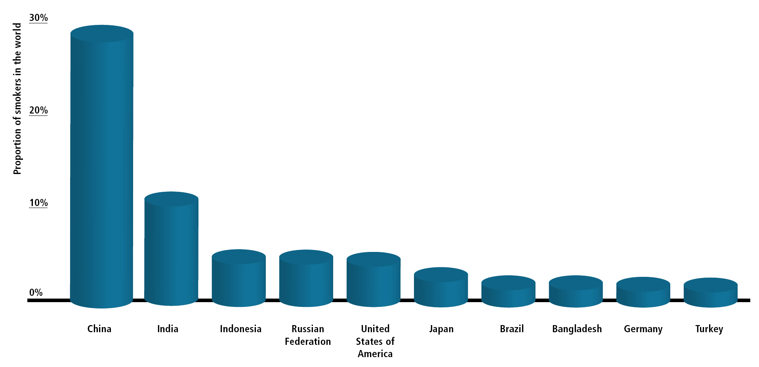
全世界约三分之一的吸烟者生活在中国
占全世界吸烟者的比例
More than 40% live in just 2 countries
中国
印度
印度尼西亚
日本
巴西
孟加拉国
德国
土耳其
俄罗斯联邦
美国
9
Notes:
The MPOWER Package
9
The tobacco epidemic will cause the most harm to low-income and moderate-income countries with high population
The tobacco industry is expanding its advertising, marketing and promotion to the developing world to capture these growing millions of potential customers
Tobacco use is growing fastest in these countries, fueled by steady population growth. This will create a ‘perfect storm’ of future tobacco-related disease and death
Because developing countries are still in the early stages of the tobacco epidemic, they have yet to experience the full impact of tobacco-related disease and death already evident in wealthier countries where tobacco use has been common for much of the past century
Many of these countries have fewer resources to respond to the health, social and economic problems caused by tobacco use, which will exacerbate the tobacco epidemic’s impacts
Tobacco-related disease and death will hit these countries very hard in the coming decades
9

Slide 10
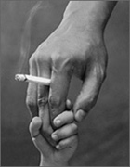
中国有
540,
000,
000
被动吸烟者
Notes:
No safe level of second-hand smoke
Smoke-free environments protect non-smokers’ health, help smokers quit & encourage smoke-free homes
Completely smoke-free indoor areas with no exceptions
Smoke-free laws very popular & do not harm business
Protect worker safety

Slide 11
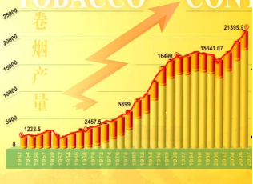
Cigarette sales trend in China

Slide 12

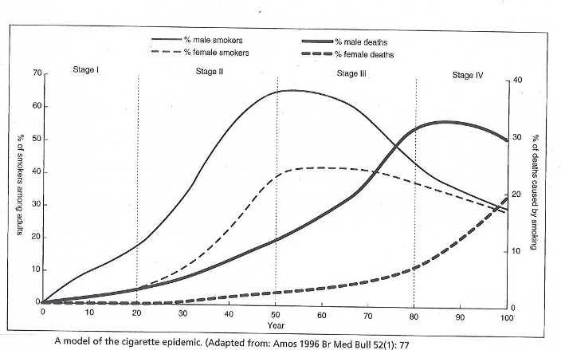
Wave of deaths in developed countries crests 30 years after smoking peak
Disease and deaths look set to climb at least until 2042
2012??
2042??

Slide 13
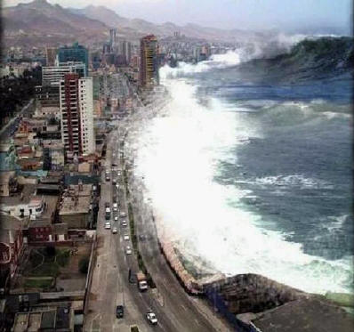
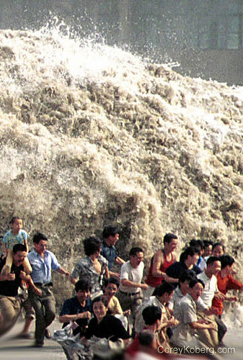
You can stop the coming Tobacco death tsunami from hitting China
Estimated tobacco costs in China (2006)
1 million deaths
74 billion yuan direct costs
8% of total health spending
420 million working days lost

Slide 14
NCDs and Poverty
Macro-economic level
2006-2015 (cumulative) | 2005 | Lost national income from premature deaths due to heart disease, stroke and diabetes
Lost national income (billions) | Lost national income (billions) | Countries
49 | 3 | Brazil
558 | 18 | China
237 | 9 | India
8 | 0.4 | Nigeria
31 | 1 | Pakistan
303 | 11 | Russian Federation
3 | 0.1 | Tanzania
WHO: "Heart disease, stroke and diabetes alone are estimated to reduce GDP between 1 to 5% per year in low- and middle-income countries experiencing rapid economic growth"

Slide 15
Mechanisms of Tobacco Control
Notes:
15

Slide 16
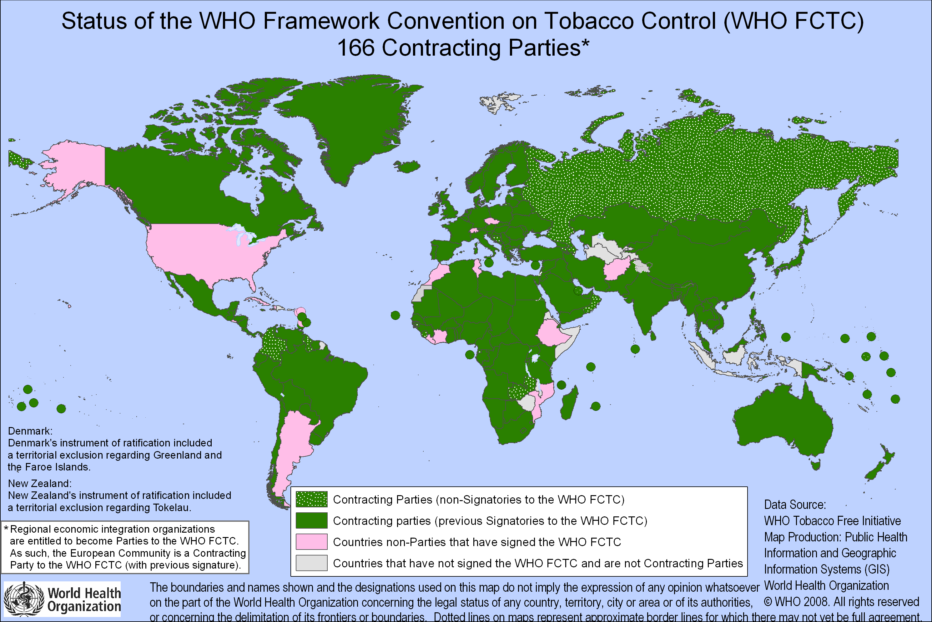
THE WHO FCTC is a landmark in public health. 172 parties

Slide 17

The WHO FCTC in China
Smoke-free public places, workplaces and public transport as well as tobacco advertising bans are required under the WHO Framework Convention for Tobacco Control.
China ratified in October 2005
WHO FCTC is binding law in China.

Slide 18
MPOWER Technical Assistance Programme: implementing the WHO FCTC demand reduction measures
MPOWER: Six Interventions to Reverse the Tobacco Epidemic
monitor tobacco use and prevention policies
protect people from tobacco smoke
offer help to quit tobacco use
warn about the dangers of tobacco
enforce bans on tobacco advertising, promotion and sponsorship
raise taxes on tobacco

Slide 19

WHO FCTC and MPOWER
An evidence-based tool for tobacco control
r
p
w
Article 6, 15
Article 8
Article 11, 12
e
o
m
Article 13
Article 14
Article 20, 21
Notes:
The placement of MPOWER logo is strategic as the MPOWER package is a tool that helps countries meet their FCTC guidelines

Slide 20
International Experiences in Implementing the WHO FCTC
Nigeria, Turkey, Mexico, England, Iran, Hong Kong, India, China, Panama, Thailand

Slide 21

WHO FCTC Article 20 & 21
(Monitor Tobacco Use and Prevention Policies)
Monitoring tobacco industry
activities in Nigeria
  NGO "Environmental Rights Action/Friends of the Earth" (ERA/FOTE) has identified the industry’s unfair practices toward tobacco farmers and indifference to the use of child labor
  Revealed the existence of industry-sponsored events that appeal to youth where cigarettes and tobacco-related merchandise have been distributed freely
  Uncovered industry co-operation programs with various government institutions and corporate social responsibility initiatives
Notes:
21
Egypt : Successful national school-based smoke free campaign held. This is creating 100% smoke-free schools (Ministry of Education in collaboration with MoH and The Directorate of Environmental Affairs).
Brazil: Decree passed on 12 May 2008 to ban smoking in all enclosed public places in Rio de Janeiro.
Mexico: Federal Tobacco Control law was approved and a 100% smoke-free law was approved in Mexico City on 30 May 2008, "Health Protection of Non-Smokers Law". The level of compliance is good, even though many actions against the law are under consideration.
Turkey: The national Tobacco control law was amended and signed by the President. The revised law provides 100% smoke-free public and workplaces with some minor exceptions. The first phase of 100% smoke-free public and workplaces will enter into force on 19 May 2008.

Slide 22
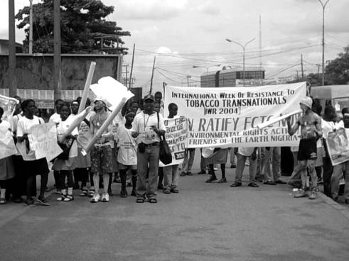
WHO FCTC Article 20 & 21
(Monitor Tobacco Use and Prevention Policies)
Monitoring tobacco industry activities in Nigeria, cont'd
  ERA/FOTE strengthened the capacity of smaller organizations to become engaged in industry monitoring and grassroots advocacy
  Spearheading formation of the Nigeria Tobacco Control Alliance, a coalition of NGOs active in the fight against tobacco
Notes:
22
Egypt : Successful national school-based smoke free campaign held. This is creating 100% smoke-free schools (Ministry of Education in collaboration with MoH and The Directorate of Environmental Affairs).
Brazil: Decree passed on 12 May 2008 to ban smoking in all enclosed public places in Rio de Janeiro.
Mexico: Federal Tobacco Control law was approved and a 100% smoke-free law was approved in Mexico City on 30 May 2008, "Health Protection of Non-Smokers Law". The level of compliance is good, even though many actions against the law are under consideration.
Turkey: The national Tobacco control law was amended and signed by the President. The revised law provides 100% smoke-free public and workplaces with some minor exceptions. The first phase of 100% smoke-free public and workplaces will enter into force on 19 May 2008.

Slide 23
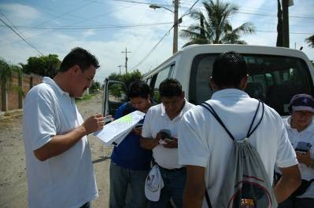
WHO FCTC Article 20 & 21
(Monitor Tobacco Use and Prevention Policies)
Turkey expands tobacco use surveys
  Turkey first implemented the Global Youth Tobacco Survey (GYTS) and WHO’s World Health Survey in 2003
  In 2009, repeated the GYTS with nationally representative sample
  In January 2009, Turkey was the first country to complete data collection for the Global Adult Tobacco Survey (GATS)
Notes:
23
Egypt : Successful national school-based smoke free campaign held. This is creating 100% smoke-free schools (Ministry of Education in collaboration with MoH and The Directorate of Environmental Affairs).
Brazil: Decree passed on 12 May 2008 to ban smoking in all enclosed public places in Rio de Janeiro.
Mexico: Federal Tobacco Control law was approved and a 100% smoke-free law was approved in Mexico City on 30 May 2008, "Health Protection of Non-Smokers Law". The level of compliance is good, even though many actions against the law are under consideration.
Turkey: The national Tobacco control law was amended and signed by the President. The revised law provides 100% smoke-free public and workplaces with some minor exceptions. The first phase of 100% smoke-free public and workplaces will enter into force on 19 May 2008.

Slide 24
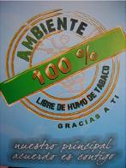
WHO FCTC Article 8
(Protect People from Tobacco Smoke)
Mexico Federal District goes 100% smoke-free
  Mexico Distrito Federal (Mexico City or Mexico DF), with a population of nearly 9 million, passed a comprehensive smoke-free law in February 2008.
  By joining other large subnational jurisdictions that have become smoke-free, Mexico DF serves as a catalyst for similar action throughout Latin America and around the world.
Notes:
24
Egypt : Successful national school-based smoke free campaign held. This is creating 100% smoke-free schools (Ministry of Education in collaboration with MoH and The Directorate of Environmental Affairs).
Brazil: Decree passed on 12 May 2008 to ban smoking in all enclosed public places in Rio de Janeiro.
Mexico: Federal Tobacco Control law was approved and a 100% smoke-free law was approved in Mexico City on 30 May 2008, "Health Protection of Non-Smokers Law". The level of compliance is good, even though many actions against the law are under consideration.
Turkey: The national Tobacco control law was amended and signed by the President. The revised law provides 100% smoke-free public and workplaces with some minor exceptions. The first phase of 100% smoke-free public and workplaces will enter into force on 19 May 2008.

Slide 26
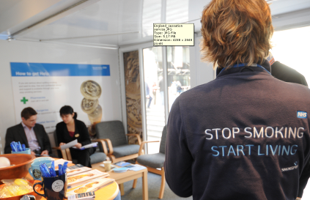
WHO FCTC Article 14
(Offer Help To Quit Tobacco Use)
England provides free, comprehensive tobacco dependence treatment to all
Any smoker can go to a general practitioner and be referred to specialized treatment, or go directly to a treatment center, at no charge.
Two free national quit lines
NRT is available without prescription through pharmacies and in other stores. NRT and other smoking cessation medications are also available by prescription at a reduced charge.
Notes:
26
Indonesia: A top referral hospital and the Indonesian Medical Association developed new tobacco cessation centers in hospitals and private practice clinics (2008).
Bangladesh - National workshop on cessation held in May 2008.
India: STCCs of Tamil Nadu, West Bengal and Delhi have conducted workshops on Tobacco Cessation and training of trainers in Tobacco-Free Dental & Medical Colleges, as well as other training sessions on cessation (June 2008).
China: New cessation guidelines have been produced by Chaoyang Hospital. The draft guidelines were distributed at the Smoke Free Hospital Seminar held in Beijing in February 2008, as were the Chinese version of the WHO Guidelines for protection from SHS (March 2008).
Iran - Lots of work on cessation training - national training of trainers workshop on cessation, over 100 cessation centres set up.
Ghana: Training workshops for PHC providers on cessation counselling services in 12 health facilities. Guide for PHC providers to do cessation counselling has been developed (2007).
Nigeria: Training workshops have been conducted to train PHC providers on brief cessation advice. Provision of Incentives (blood pressure monitors) to encourage PHC providers to include cessation support as a component of the NCDs treatment (2007-2008) .
Nepal: Identification of smokers and provision of brief cessation advice have been incorporated into primary health care for chronic respiratory diseases and Tuberculosis(2007- June 2008).

Slide 27
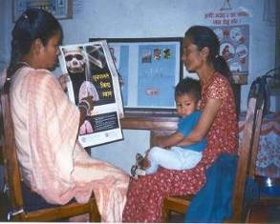
WHO FCTC Article 14
(Offer Help To Quit Tobacco Use)
Nepal: integrate tobacco cessation service into TB care
Under the leadership of National TB Programme of Nepal
Two pilot districts implementing tobacco cessation services through Practical Approach to Lung Health Strategy at all PHCs
146 health care workers from 25 PHC centres trained
Preliminary achievements
Proportion of respiratory diseases among all patients in OPD and in hospitals | 6-10%
Number and % of smokers identified among respiratory patients | 59%
Number and % of patients with respiratory diseases who are current smokers who have been given counseling to quit smoking | 22%
Notes:
27
Indonesia: A top referral hospital and the Indonesian Medical Association developed new tobacco cessation centers in hospitals and private practice clinics (2008).
Bangladesh - National workshop on cessation held in May 2008.
India: STCCs of Tamil Nadu, West Bengal and Delhi have conducted workshops on Tobacco Cessation and training of trainers in Tobacco-Free Dental & Medical Colleges, as well as other training sessions on cessation (June 2008).
China: New cessation guidelines have been produced by Chaoyang Hospital. The draft guidelines were distributed at the Smoke Free Hospital Seminar held in Beijing in February 2008, as were the Chinese version of the WHO Guidelines for protection from SHS (March 2008).
Iran - Lots of work on cessation training - national training of trainers workshop on cessation, over 100 cessation centres set up.
Ghana: Training workshops for PHC providers on cessation counselling services in 12 health facilities. Guide for PHC providers to do cessation counselling has been developed (2007).
Nigeria: Training workshops have been conducted to train PHC providers on brief cessation advice. Provision of Incentives (blood pressure monitors) to encourage PHC providers to include cessation support as a component of the NCDs treatment (2007-2008) .
Nepal: Identification of smokers and provision of brief cessation advice have been incorporated into primary health care for chronic respiratory diseases and Tuberculosis(2007- June 2008).

Slide 28
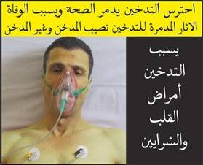
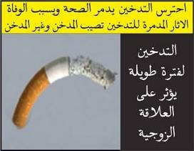
WHO FCTC Articles 11 & 12
(Warn About the Dangers of Tobacco )
Iran implements strong pack warning labels
  In 2008, Iran strengthened its law to require pictorial warnings on all cigarette packages sold in the country beginning in January 2009
  Health warnings cover 50% of both the front and back of all cigarette packages
Notes:
28
Mexico: The new federal law in Mexico includes health warnings (30% of front with a pictogram, 100% of back, 100% of one lateral), a ban on misleading descriptors.
Brazil: A new set of health warnings was presented on WNTD.
Bangladesh: Consistent dissemination of anti-tobacco messages in national print and electronic media. Taskforce Committees have been activated in regions/districts in order to advocate on health warnings.
Viet Nam: The regulation on new health warnings became effective on 1 April 2008. There are two text health warnings covering 30% of the two main surfaces.
Poland: three-month long national education campaign about the threat of tobacco use and passive smoking and health promotion amongst children and teenagers (mainly 16-19 years old) started on 31 May 2008.
Egypt - new health warnings now available.

Slide 29

WHO FCTC Articles 11 & 12
(Warn About the Dangers of Tobacco )
China and India: Mass media campaign
  China and India ran the ad “Sponge,” originally developed by the Cancer Institute New South Wales in Australia.
  The ad graphically depicts the amount of cancer-producing tar that an average smoker’s lungs soak up in just one year.
  The Government of India spent about USD 1 million for the campaign, which ran for a six-week period in June and July 2009, on 40 national and regional television channels.
Available at http://www.encyclopedia.com/video/Yj_bW8rKB44-india-sponge-campaign-by-world.aspx
Notes:
29
Mexico: The new federal law in Mexico includes health warnings (30% of front with a pictogram, 100% of back, 100% of one lateral), a ban on misleading descriptors.
Brazil: A new set of health warnings was presented on WNTD.
Bangladesh: Consistent dissemination of anti-tobacco messages in national print and electronic media. Taskforce Committees have been activated in regions/districts in order to advocate on health warnings.
Viet Nam: The regulation on new health warnings became effective on 1 April 2008. There are two text health warnings covering 30% of the two main surfaces.
Poland: three-month long national education campaign about the threat of tobacco use and passive smoking and health promotion amongst children and teenagers (mainly 16-19 years old) started on 31 May 2008.
Egypt - new health warnings now available.

Slide 30
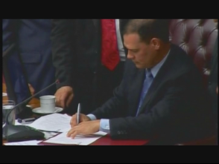
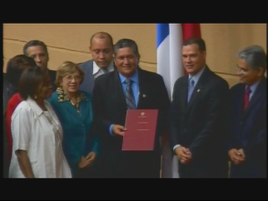
WHO FCTC Article 13
(Enforce Bans on Tobacco Advertising, Promotion and Sponsorship)
Panama bans all tobacco advertising, promotion and sponsorship
  In 2008, Panama became the first country in the Americas to enact a total ban on all advertising, promotion and sponsorship of tobacco products.
  Even though Panama’s law has been in place for less than two years, levels of compliance are extremely high, ranking 95 out of a possible 100 points.
Signing of the new legislation
Notes:
30
Mexico: A wide, but not complete, ban on advertisement, promotion and sponsorship was approved with the Federal Law in March 2008 (magazines for adults are exempted).
China: China CDC released its 2008 China Tobacco Control Report, “Protect Children and Young People by Banning Tobacco Advertising, Promotion and Sponsorship”.
Philippines: The Philippines has already banned tobacco advertising on television, cable TV, radio, cinema and outdoor ads (billboards) since 2007, and on 1 July 2008, banned all forms of mass media advertising, including printed materials.
Bangladesh: Six shopkeepers in Dhaka City were fined for having tobacco advertisement billboards on their shops in violation of the advertising ban in May. A month long World No Tobacco Day (WNTD) observed in the country, focused on ad bans. As a result the last two months have seen an aggressive response from Government Ministries - removing advertising promotion boards in the streets and running mobile courts to enforce bans in districts.
Indonesia: Implementation of a project which aims at advocating for a ban of tobacco advertising, promotion and sponsorship (May 2008).
Thailand: Training for law enforcement in order to introduce the recently developed Ministerial Notifications and to strengthen enforcement at the provincial level (May 2008).

Slide 31
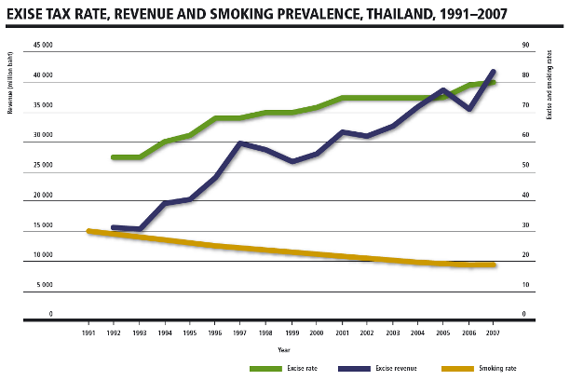
WHO FCTC Article 6
(Raise Taxes on Tobacco)
Thailand increases tobacco taxes Thailand levies an 80% ad valorem excise tax on all categories of cigarettes
Notes:
31
Bangladesh: Signature campaigns and major advocacy drives resulted in the Finance Adviser to the Caretaker Government of Bangladesh announcing new taxes on tobacco. This was followed by an announcement from the President in June to increase taxes. 60% taxes are now imposed on material and 20% on packaging.
Viet Nam: raised tobacco excise taxes to 65% of the factory price, up from 55%.
Pakistan: The Technical Advisory Group on tobacco control (high level political group) has been activated, and it has submitted recommendations to the government to increase taxation on tobacco products.

Slide 32
Some thoughts on tobacco control
Notes:
32

Slide 33

“Setting an example is not the main means of influencing another, it is the only means.” Albert Einstein.
Notes:
“Learning is like rowing upstream: not to advance is to drop back.” We need to make sure that we are moving forward in the fight against the tobacco epidemic.
Health professionals need to be leaders in the fight against tobacco. We need to quit smoking ourselves, and lead the movement against tobacco at all levels: health facility level, municipal level and nation-wide.

Slide 34
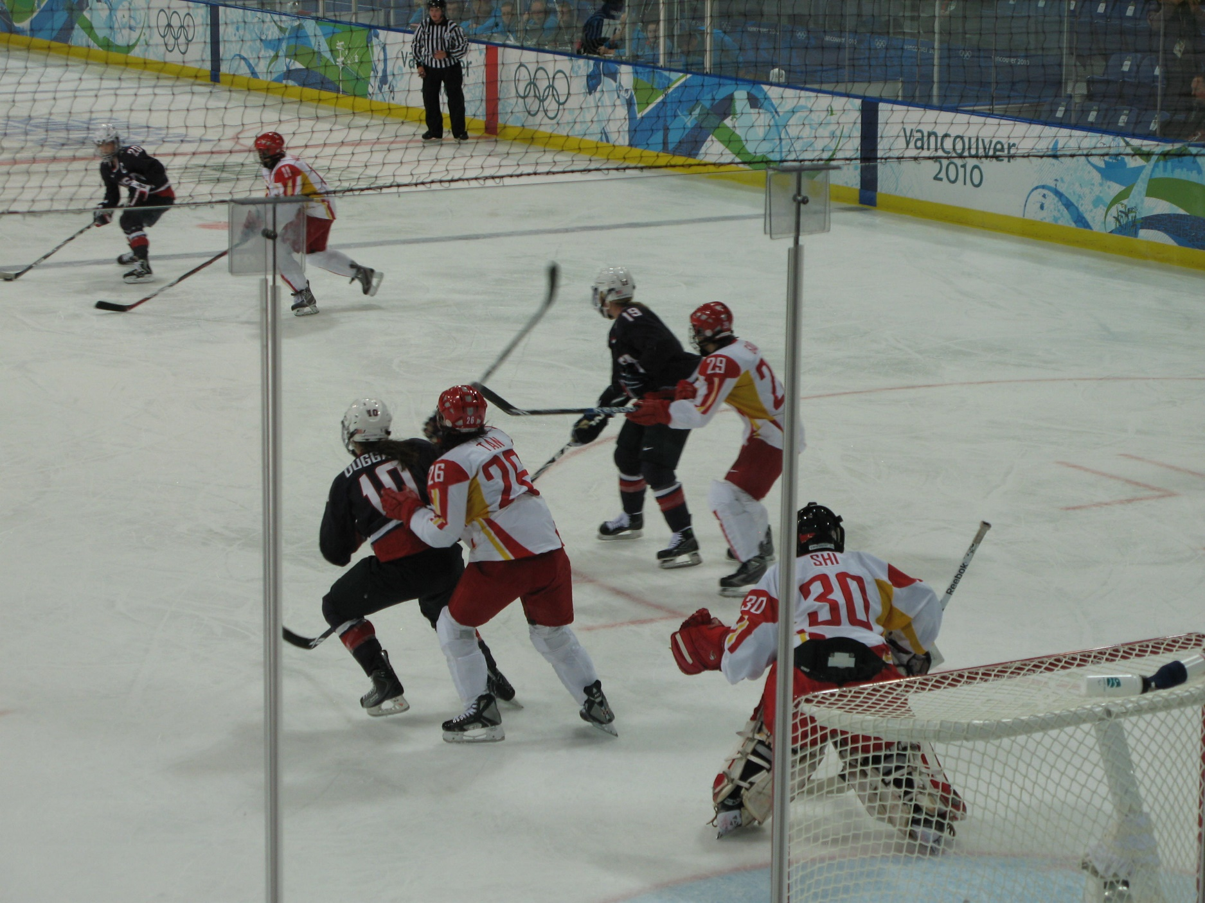
A little error may lead to a large discrepancy.
Cha zhi hao li, shi zhi qian li.
Notes:
This proverb advises that when doing something one must make every effort to be careful and exact, because even a tiny mistake can lead to a great loss. Tobacco control is a relatively new area in China and many policies, guidelines, and regulations are in development, including curriculum development. It is very important to make sure these policies are as close to perfection as we can make them. A small error may lead to ineffective policies and a failed mission.

Slide 35

Keep the goal in sight while tackling daily tasks
Da chu zhuoyan, xiao chu zhuoshou.
Notes:
This proverb advises us to always keep the overall situation in mind and be far-sighted while we set our hands to mundane business. Tobacco control is a marathon, not a sprint. Right now, demand for cessation services is not great, because we haven't built the system. People will want to quit smoking when they get that advice over and over from their doctor, when there are hard-hitting labels on the cigarette packs, when there are no ads urging them to smoke, when they can no longer smoke indoors, and when cigarettes are very expensive. Together these things will work to bring your patients to you asking for help. Health professionals have to be prepared with the right answers to give their patients who want to quit smoking, and they have to know how to motivate their smoking patients to quit. The first step is to make sure that you don't smoke yourselves. As medical professionals, you need to take the lead. The second is to make sure all doctors give brief cessation advice to all patients. This is the mundane business of tobacco control. However, these steps are necessary to combat tobacco, the biggest agent of death on the planet.

Slide 36

When people are of one mind and heart, they can move Mount Tai
Renxin qi, Tai Shan yi
Notes:
There is a global movement for tobacco control. Today you are part of that movement. Together we can stop the tobacco epidemic. WHO applauds you for your commitment and dedication and I wish you a very productive training.

